Slide 2
Welcome from the Chair of Trustees
Dear Candidate,
As chair of the Trustees, I would like to thank you for your interest in becoming the next Chief Executive Officer of the Success For All Educational Trust. Needless to say, this is a crucial position in our organisation and just as you will want it to be the right one for you, we too want the right person; someone who will not only be successful but also enjoy their work and relish the challenges and experiences the job offers.
As our first CEO, Paul Ward, retires, we are keen to find in his successor a person equally committed to improving the educational and personal outcomes for every single one of our 3,100 pupils at our five academies such that they become well-rounded citizens of the future who make a valuable contribution to society.
All of our academies have recently been subject to inspection by Ofsted and have been graded Good or Outstanding. So we are now well positioned to enter the next exciting stage in the development of the Trust.
Whilst retaining our relentless focus on the quality of education, one of our objectives is “Growth” and we interpret this in a multi-faceted way so that we can extend the impact of our practices on a larger number of children. This will include increasing the number of children attending our schools where there is space available, broadening our provision (including Additionally Resourced Provision and Alternative Provision) and expanding the number of academies within our trust. Growth will form one of the key objectives of the CEO.
The successful candidate will also have the personal capacity to lead a different and potentially substantially larger organisation than we are now and will be able to develop their role accordingly.
Is that you? If it is, we look forward to hearing from you.
Neil Yeomans
Chair of the Board of Trustees
Success for All Educational Trust

Slide 3
Welcome from the CEO
Dear Candidate,
Thank you for requesting this recruitment pack and for taking the time to consider the role of CEO of The Success For All Educational Trust (SFAET). I am very proud to be the founding CEO of a Trust that is committed to the success of all the students in our care.
The students in our Trust deserve the very best leaders and teachers and we now seek an exceptional candidate as our next CEO. This is a fantastic opportunity to lead the Trust through the next stage of development as all of our schools work towards gaining or maintaining an outstanding Ofsted grading. The new CEO will oversee all of our schools in delivering the Trust's core purpose of ensuring that all children receive an excellent and ambitious education and are as successful as possible.
Our Trust is currently Havering based and composed of three secondary schools - Redden Court, Sanders Draper and The Royal Liberty Schools which together form our secondary wing and two primary schools, Rise Park Junior and Rise Park Infant, which together form our primary wing.
Our vision as a Trust is focused on a 'Commitment to Success for All' and high levels of aspiration for every member of our community. The Trust is forward thinking and progressive. We seek to achieve the very best for our students through the use of a rich variety of educational approaches.
In all of our schools we insist upon an inclusive approach to learning, innovative teaching, a broad and balanced curriculum and strong pastoral systems. The welfare and development of all our staff is considered by us to be a vital element of school and Trust improvement with all staff encouraged and enabled to avail of CPD opportunities.
These are exciting times for the SFAET as it expands and develops. I am very proud as the outgoing CEO to leave behind a group of flourishing schools with dynamic leadership and strong reputations in the local community. On a personal level we are looking for an individual who shares our overall vision and who has the personality, energy and drive to contribute to our exciting future.
Perceptions play a major part in choosing the right employer for the next phase of your career. I strongly urge you to come and visit our central offices based at The Royal Liberty School and to meet key staff prior to application.
To book an appointment to visit and discuss the role please email Julia Woodstock our Executive Assistant at jwoodstock@sfaet.co.uk
I look forward to meeting you and receiving your application.
Mr Paul Ward
CEO of The Success for All Educational Trust

Slide 4
CEO
Job Advert
Competitive Annual Salary of £160K+
Hours: Full time.
Preferred start date January 2025 with flexibility to extend to Easter 2025
Location: Based in the Trust offices at The Royal Liberty School
Due to the upcoming retirement of our CEO, The Success for All Educational Trust wishes to appoint in a full time capacity, an outstanding and dynamic CEO to work closely with the Trust Board in leading our Trust through the next stage of its development and growth. The successful applicant will be in charge of The Success for All Educational Trust, reporting directly to the Trust Board. The CEO will work collaboratively with SFAET schools to ensure the best possible outcomes for students. The CEO is responsible for providing leadership that articulates the Trust’s vision and values in practice, defines and delivers the Trust’s strategy and shapes its ongoing development. The CEO, through inspirational leadership, oversees all operations of the Trust – including enabling school and organisational improvement at scale, compliance, the mitigation of risk and building strategic partnerships with stakeholders to ensure both strong educational outcomes for pupils and the sustainable development of the Trust. The successful candidate will be an experienced, dynamic and collaborative leader, who can drive forward the Trust’s Development and Growth Plans and develop the schools in ways that will bring increased consistency and effectiveness across the organisation. They will demonstrate exceptional interpersonal and communications skills, as well as sound judgement and resilience. They will be aligned with the Trust’s vision and values and passionate about improving the life chances of children and young people through education and experiences.
The Success for All Educational Trust was formed in September 2017 and currently consists of five academies in the London Borough of Havering: Redden Court School: The Royal Liberty School: Sanders Draper School: Rise Park Junior School and Rise Park Infant School.
Our mission is: ‘To work together to support ambition and excellence in education’.
At the core of everything we do is our Commitment to
‘Success for All’
Our vision as a Trust is focused on a 'Commitment to Success for All' and high levels of aspiration for every member of our community. The Trust is forward thinking and progressive. We seek to achieve the very best for our students through the use of a rich variety of educational approaches. In all of our schools we insist upon an inclusive approach to learning, innovative teaching, a broad and balanced curriculum and strong pastoral systems. The welfare and development of all of our staff is considered by us to be a vital element of school and Trust improvement with all staff encouraged and enabled to avail of CPD opportunities.
The ideal candidate will have:
Substantial and impactful senior leadership experience at Headship or equivalent executive level
Excellent interpersonal, communication and organisational skills
Experience of leading and managing organisational performance with a relentless focus on improving outcomes
Evidence of the ability to motivate, develop, support and challenge staff
Evidence of strong influencing and negotiating skills
Evidence of the ability to actively engage politically and strategically
Evidence of the ability to plan effectively
Evidence of developing organisational culture including the ability to embrace and influence change, and develop organisational resilience
In depth knowledge and experience of child protection, safer recruitment and safeguarding procedures
Commitment to diversity, equality and inclusion
Commitment to actively seek new approaches, ideas and challenges
Be able to take difficult decisions when under pressure
Be ambitious for the Trust to grow in the future
The Success for All Educational Trust is committed to safeguarding and promoting the welfare of children and young people and expects all members of staff to share this commitment. An Enhanced DBS disclosure is required for this post.
We welcome enquiries from everyone and value diversity in our workforce. Applications are welcome from all sections of the community regardless of gender, gender identity, ethnic origin, disability, marital status, age or sexual orientation.
References from three previous employers will be sought prior to interview.
Applicants from the previous round of interviews, need not apply.
Deadline for applications:
Please Apply here by 9 a.m. on Tuesday 2nd July 2024
Shortlisted candidates will be invited to an interview, selection and assessment process to be held on week commencing Monday 15th July 2024

Slide 5
CEO
Job Description
JOB DESCRIPTION
CHIEF EXECUTIVE OF THE SUCCESS FOR ALL EDUCATIONAL TRUST (SFAET)
Post Holder: Chief Executive Officer
Starting Salary: £160k +
Reporting to: The Trust Board
Full Time Post
Main Responsibility
The Chief Executive Officer will be an outstanding strategic leader, who is able to develop and articulate the vision, values and ethos for the SFAET and who will inspire and empower others to share in achieving it. The CEO will be accountable and take responsibility for the performance of all academies within the Trust: a driven leader who will be committed to creating the optimum educational opportunities for all students across the Trust.
Key Accountabilities:
Strategic
• Develop and facilitate the Trust in accordance with the Trust Board’s and Academies stated aims, objectives and values
• Develop and implement an effective corporate environment that allows the Trust and its constituent academies to achieve excellence
• Take responsibility for the Trust’s long term strategic plan, self-evaluation and improvement plans of the Academies; and in particular lead the growth and development of the Trust in line with the local demographic
• Together with the Trust Board ensure robust and appropriate proactive risk mitigation and management for the Trust and that the risk strategy is aligned to local academy risk strategies
• Create a culture of constant improvement and be an inspirational leader, committed to the highest achievement in all areas of the Trust’s work
• Develop and maintain effective relationships with the Regional Director (RSD) and Department for Education (DfE), Education and Skills Funding Agency (ESFA), Local Authority, Trustees, Headteachers and committee members in order to ensure the success of the Trust and its academies
• Maintain an outward facing role with the local community on behalf of the Trust to further its external relationships, future growth and development and also in support of the individual academies within the SFAET
Leadership and Management
• Be proactive and drive the strategic priorities ensuring that the Trust Development Plan is fully aligned and in tune with the local academy plans
• Lead & manage all operations through the agreed organisation structure and accountability matrix, and through the development, implementation and review of Trust level policies to achieve the Board’s stated objectives
• Ensure the effective capture of all data to meet statutory and legislative standards • Provide motivational and inspirational leadership at all levels of the organisation
• Ensure the Trust’s management and organisational structures are fit for purpose and facilitate continuous improvement
• Support the Chair of the Trustees in their strategic role of leading and supporting the Local Governance Committee Chairs

Slide 6
CEO
Job Description
Ensure that there are clear quality assurances systems embedded across the Trust that drive consistency and improvement in performance.
• Achieve effective communication, both internally and externally to the Trust, including liaising with all stakeholders and the local and national media.
Resources / Change Management
• Develop and effectively and efficiently manage the learning environment, resources (people/assets/finances) and facilities of each academy within the Trust; with particular emphasis on the planning and development required to support the forecast growth in student numbers at the academies.
• Accountable for large scale asset management across the estate including the oversight of major capital projects.
• Work closely with the Local Authority and local academy leaders in the school design and development.
• Ensure the Trust effectively manages its talent through strategic and local CPD and succession planning.
• Be responsible for meeting the demands of changing legislation, new initiatives and changing practice.
• Lead, oversee and advise on the allocation of resources across the Trust.
• In line with the agreed Trust models of delegation - select, train, develop, empower and motivate the senior staff of the Trust; appoint associate consultants as appropriate; and support academy headteachers in local academy recruitment and staff development.
Teaching & Learning/School Improvement
• Be accountable for all aspects of Teaching and Learning and Standards across the Trust, set high professional standards and ensure the education vision is understood and embraced.
• Be responsible for developing and leading the process for improvement across the Trust, providing quality assurance and accountability; this will be achieved through a rigorous and robust system of target setting which will be reviewed regularly by the CEO, who will report progress to the Trust Board.
• Provide dynamic and strategic direction and leadership for Teaching and Learning across the academies
• Lead a Trust-wide improvement function that will ensure that the requirements in each academy’s performance are identified and analysed, appropriately costed and prioritised solutions are developed and secured. This includes the commissioning of internal resources through academy-to-academy support and/or external support
from a range of providers or individuals who meet strict and agreed criteria for quality, including evidence of effectiveness and impact.

Slide 7
CEO
Job Description
Finance and Procurement
• The CEO will be the Accounting Officer for the Trust ensuring that it works to the standards set out in the Academies Handbook.
• Ensure the long term financial sustainability, by confirming that proper financial systems are established and effectively monitored, that appropriate action is recommended to address problems identified and to ensure that the Trustees are presented with accurate and timely financial reports.
• Develop and maintain a strong and effective relationship with the DfE, ESFA and relevant funding bodies to ensure the funding streams are secured that support the forecast growth.
• Review and approve annual budgets of each of the academies in the Trust. Ensure that all budgetary targets are met by individual academies and efficiencies are maximised.
• Through the most appropriate agreed roles within the Trust structure, to negotiate and agree optimum prices with various service providers in order to achieve economies of scale, and to adopt the appropriate procurement process.
• Develop and implement strategies for the generation of additional revenue and resources for the Trust.
Compliance
• Ensure that Trust meets all legislative and statutory requirements, including Health and Safety, Safeguarding and those required by Companies House and the Charity Commission, Data Protection and the Master and Supplementary Funding agreements.
Partnerships.
• Develop and lead a partnership strategy that ensures the Trust and its academies participate in local, national and international education networks.
• Identify key agencies, individuals and groups that could enhance the delivery of the Trust’s strategy at local level and build relationships locally, nationally and internationally to secure their support in partnership with the relevant personnel from the academies.
• Share skills expertise and capacity across the Trust and its academies and embed system leadership practice.
• Build and maintain strong relationships with parents/carers, students, staff, directors and governors across the Trust.
This job role is not exhaustive; the post holder may be required to undertake other such duties commensurate with the post and salary grade, as may from time to time be assigned by the Trustees.
This document will be reviewed at appropriate intervals and may be subject to modification or amendment at any time following consultation with the post holder.
The post holder will be required to travel to any of the Trust Academies within the Success for All Educational Trust and attend meetings with external stakeholders as required which may be outside of normal business hours.

Slide 8
Person Specification
Criteria | Essential | Desirable
Qualifications and Experience | - Substantial impactful senior leadership experience at Headship or equivalent executive level in a complex organisation. - Experience of leading and managing organisational change with a relentless focus on improving outcomes - Evidence of the ability to motivate, develop, support and challenge staff - Evidence of strong influencing and negotiating skills - Evidence of the ability to actively engage politically and strategically - Evidence of the ability to plan effectively - Evidence of developing organisational culture including the ability to embrace and influence change, and develop organisational resilience - Clear, practical vision for learning pedagogy from ages 3 to 18 - Successful experience of effective financial and resource management to achieve educational priorities and ensure efficiency and value for money - In depth knowledge and experience of child protection, safer recruitment and safeguarding procedures - Educated to degree level or equivalent | - Considerable experience of Inspection or school improvement - Experience of working in primary and secondary schools - Understanding of EYFS, the National Curriculum and the public examinations system requirements from ages 3 to 18 - Professional expertise in developing and delivering visionary curriculum leadership - Track record of successful leadership of significant educational improvement strategies - Educated to Masters degree level or higher and/or possess a leadership qualification e.g. NPQEL in education or studying to achieve this
Professional and Personal Attributes | - Outstanding leader, committed to distributive leadership and teamwork - A visible high-profile role model with a professional approach that commands excellence, confidence, trust and respect of the Trust and the wider community - Passionate commitment to the academic, personal and social development of young people and families - Excellent interpersonal, communication and organisational skills - Commitment to diversity and equality - Committed to actively seek new approaches, ideas and challenges - Be able to make difficult decisions when under pressure
Other | - A commitment to uphold and promote equality of opportunity - A deep commitment to the vision, values and aim of the Trust - Effective media and PR presence capable of representing the Trust and managing crisis communications and reputational risk. | - Understanding and connections with relevant government officials and policymakers within the educational realm, such as the Local Authority, Department for Education, Regional Director, Education and Skills Funding Agency, and Office for Standards in Education (Ofsted).

Slide 9
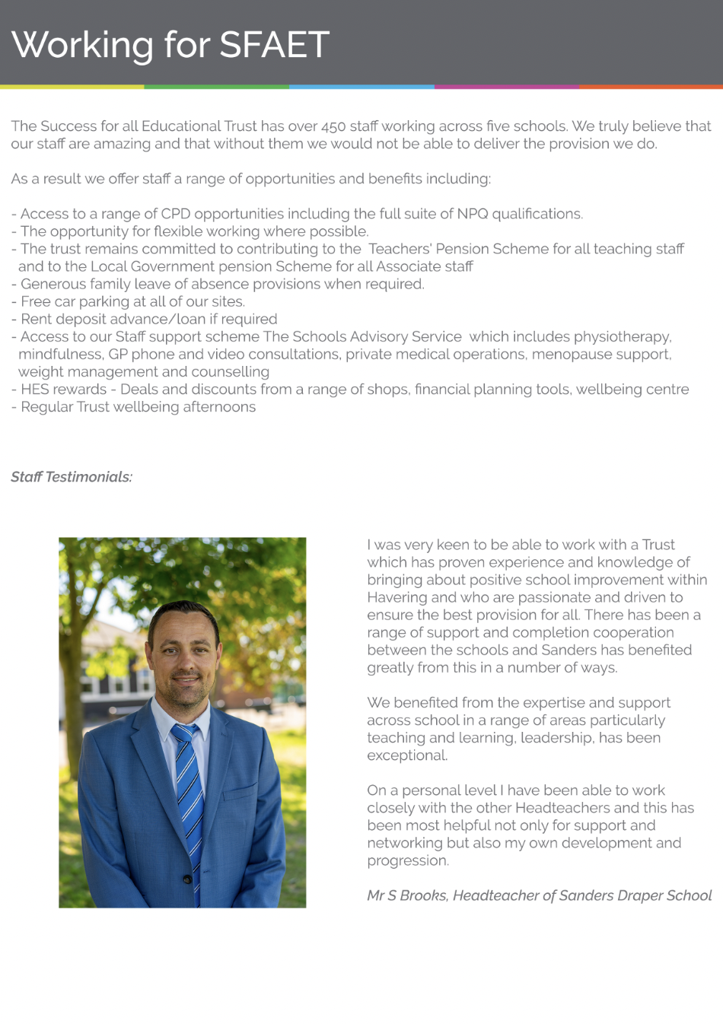

Slide 10
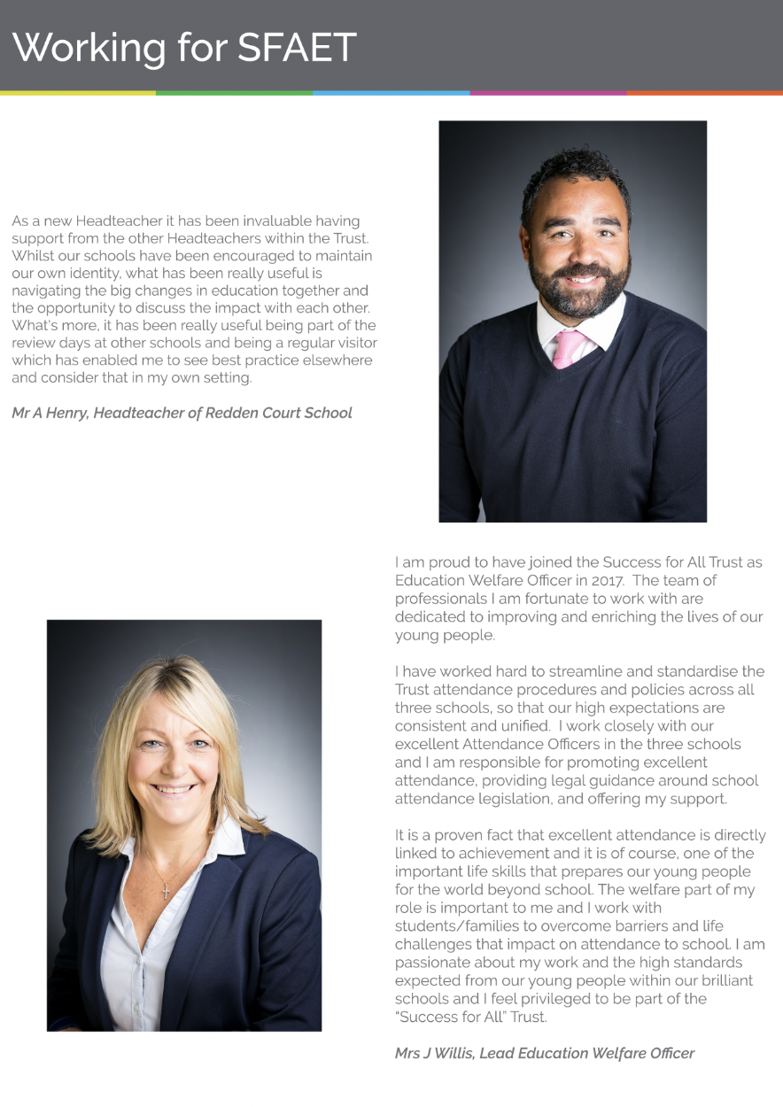

Slide 11
Staff Benefits
The Success for all Educational Trust has over 450 staff working across five schools. We truly believe that our staff are amazing and that without them we would not be able to deliver the provision we do. As a result we offer staff a range of opportunities and benefits including:
Access to a range of CPD opportunities including the full suite of NPQ qualifications
The opportunity for flexible working where possible
The Trust remains committed to contributing to the Teachers' Pension Scheme for all teaching staff and to the Local Government pension Scheme for all Associate staff
Generous family leave of absence provisions when required
Free car parking at all of our sites
Rent deposit advance/loan if required
Access to our Staff support scheme The Schools Advisory Service which includes physiotherapy, mindfulness, GP phone and video consultations, private medical operations, menopause support, weight management and counselling
HES rewards - Deals and discounts from a range of shops, financial planning tools, wellbeing centre
Regular Trust wellbeing afternoons

Slide 12
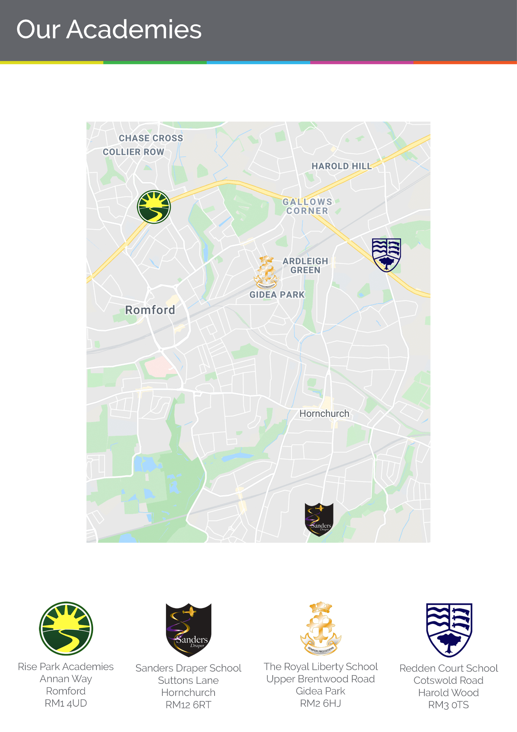

Slide 13
