Slide 1
A Flavour of Crownfield Junior

Slide 2
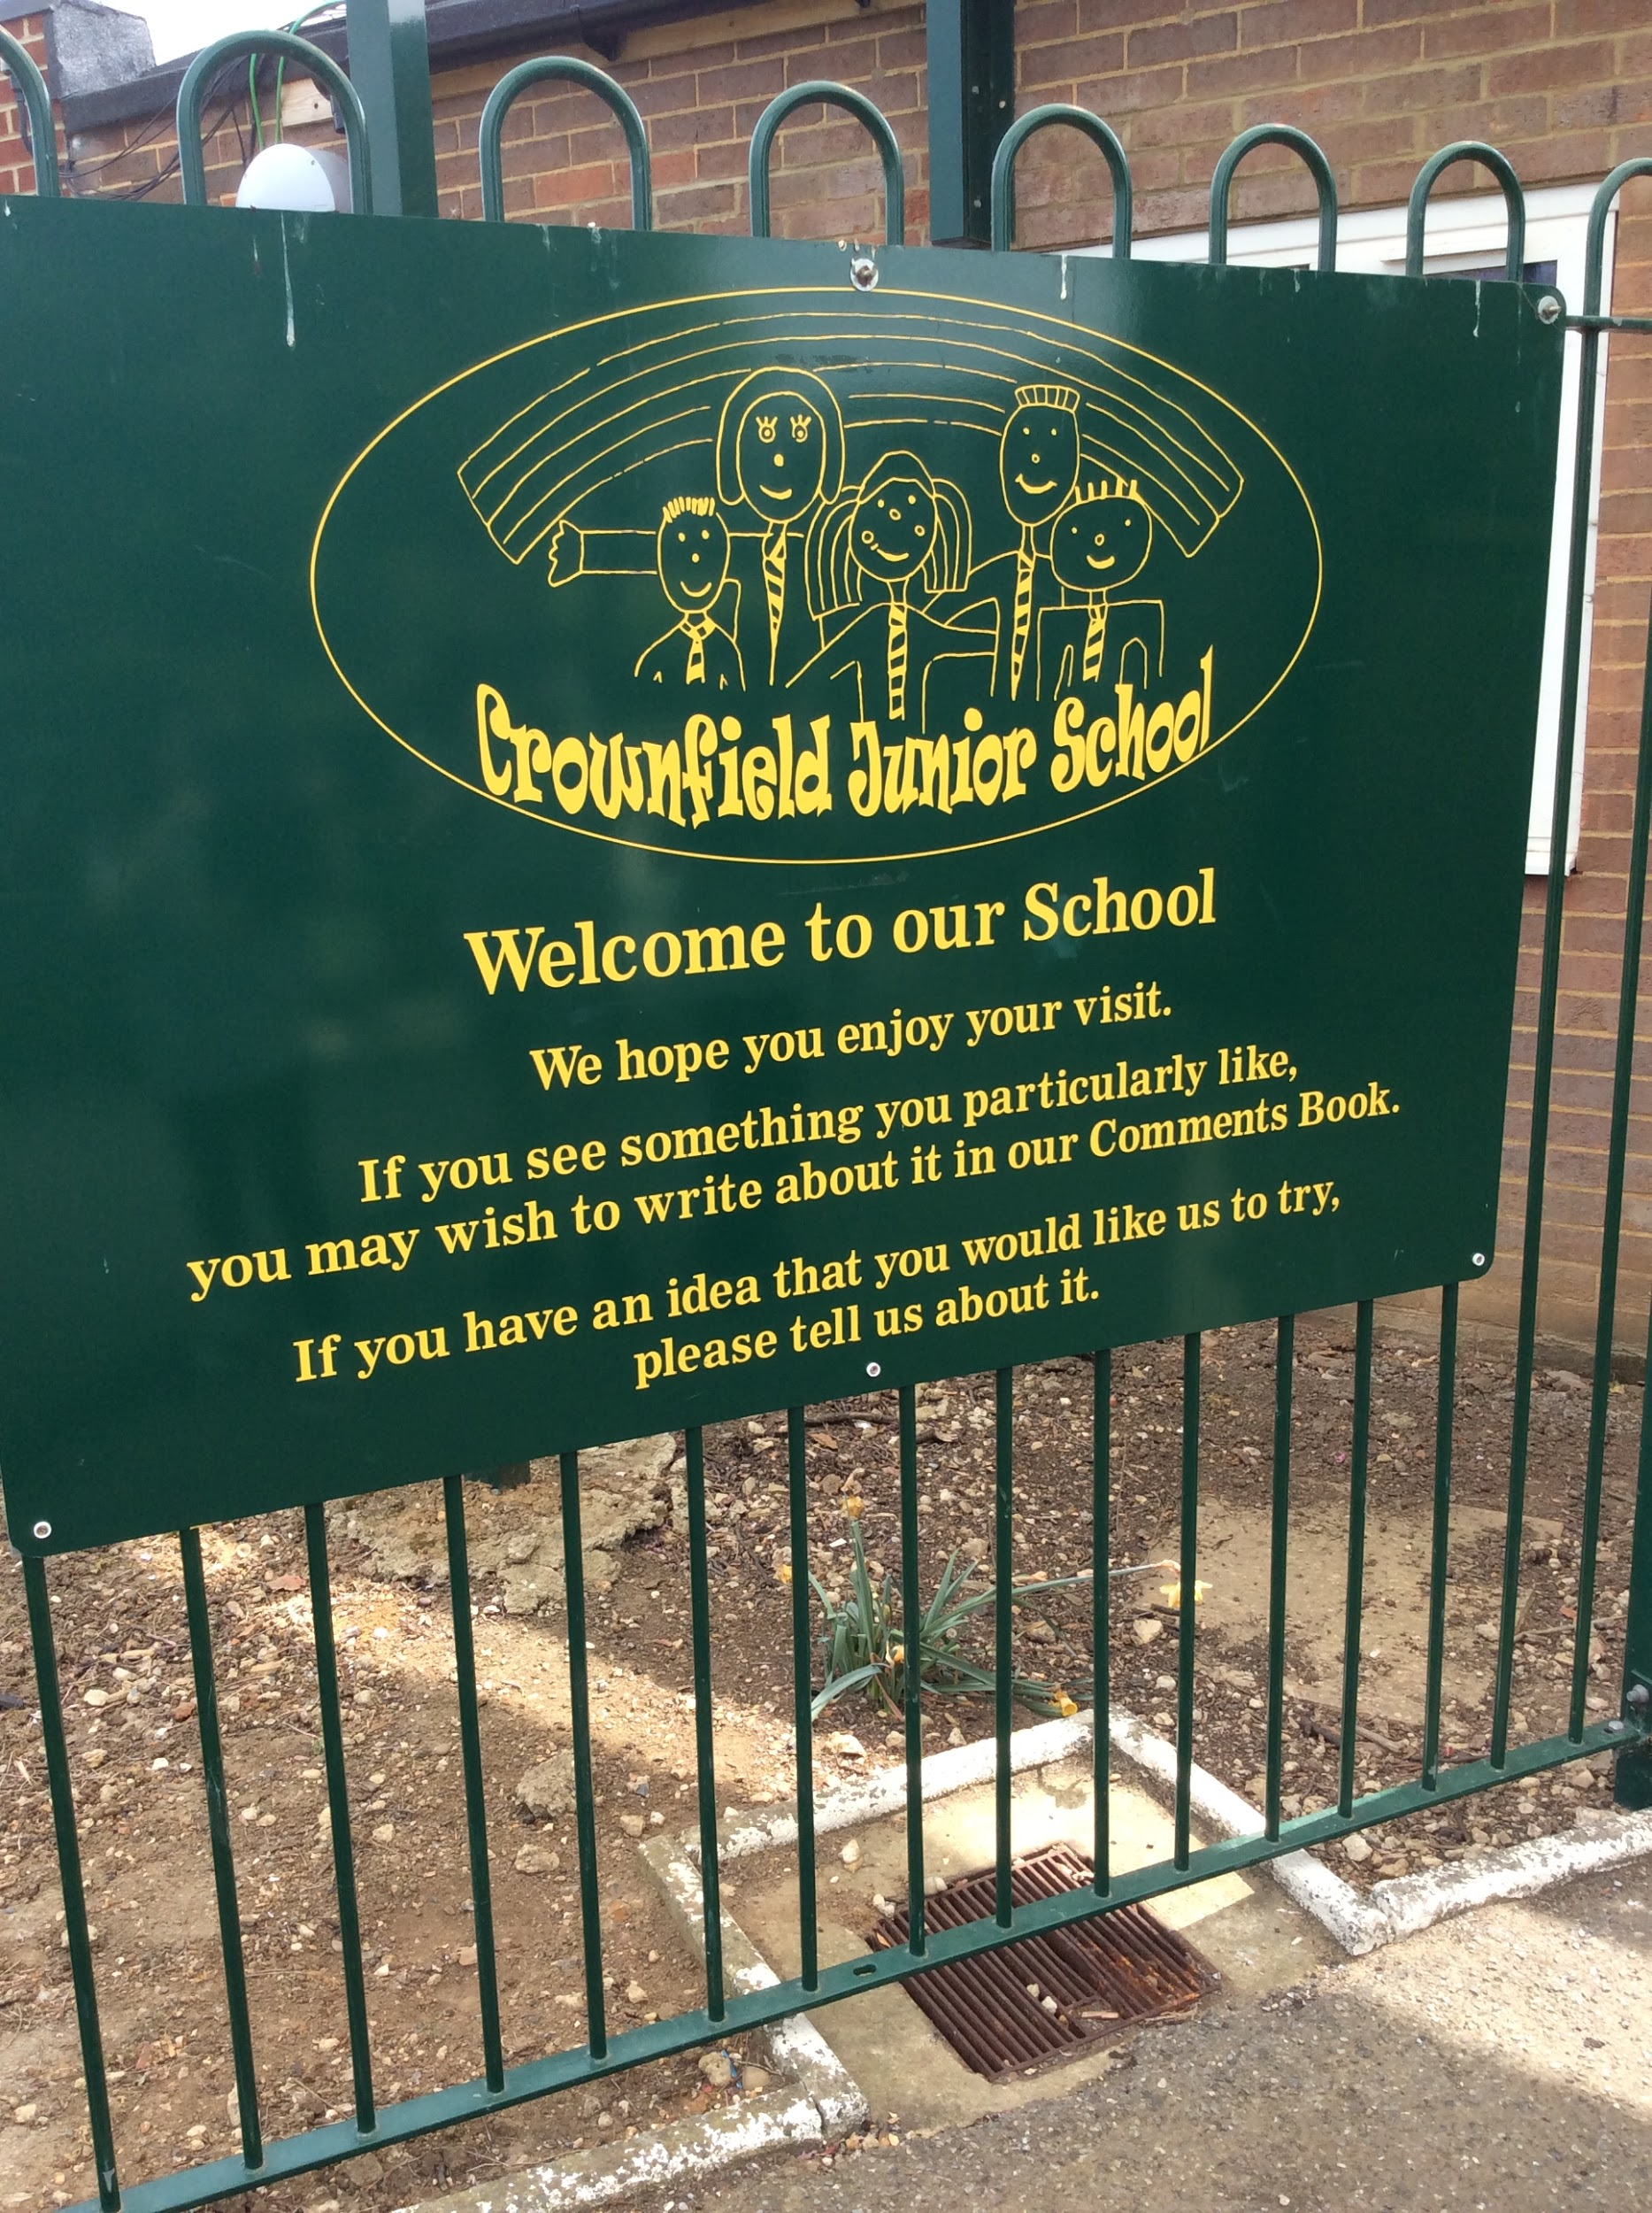

Slide 3
A typical classroom

Slide 4
We love our music!

Slide 5
We have a cosy library with a librarian!

Slide 6
We are very lucky to have lots of open fields (although some has the expansion work on it!)

Slide 7
Every child as a hand on display in the hall to symbolise that we are a team

Slide 8
We support our local community

Slide 9
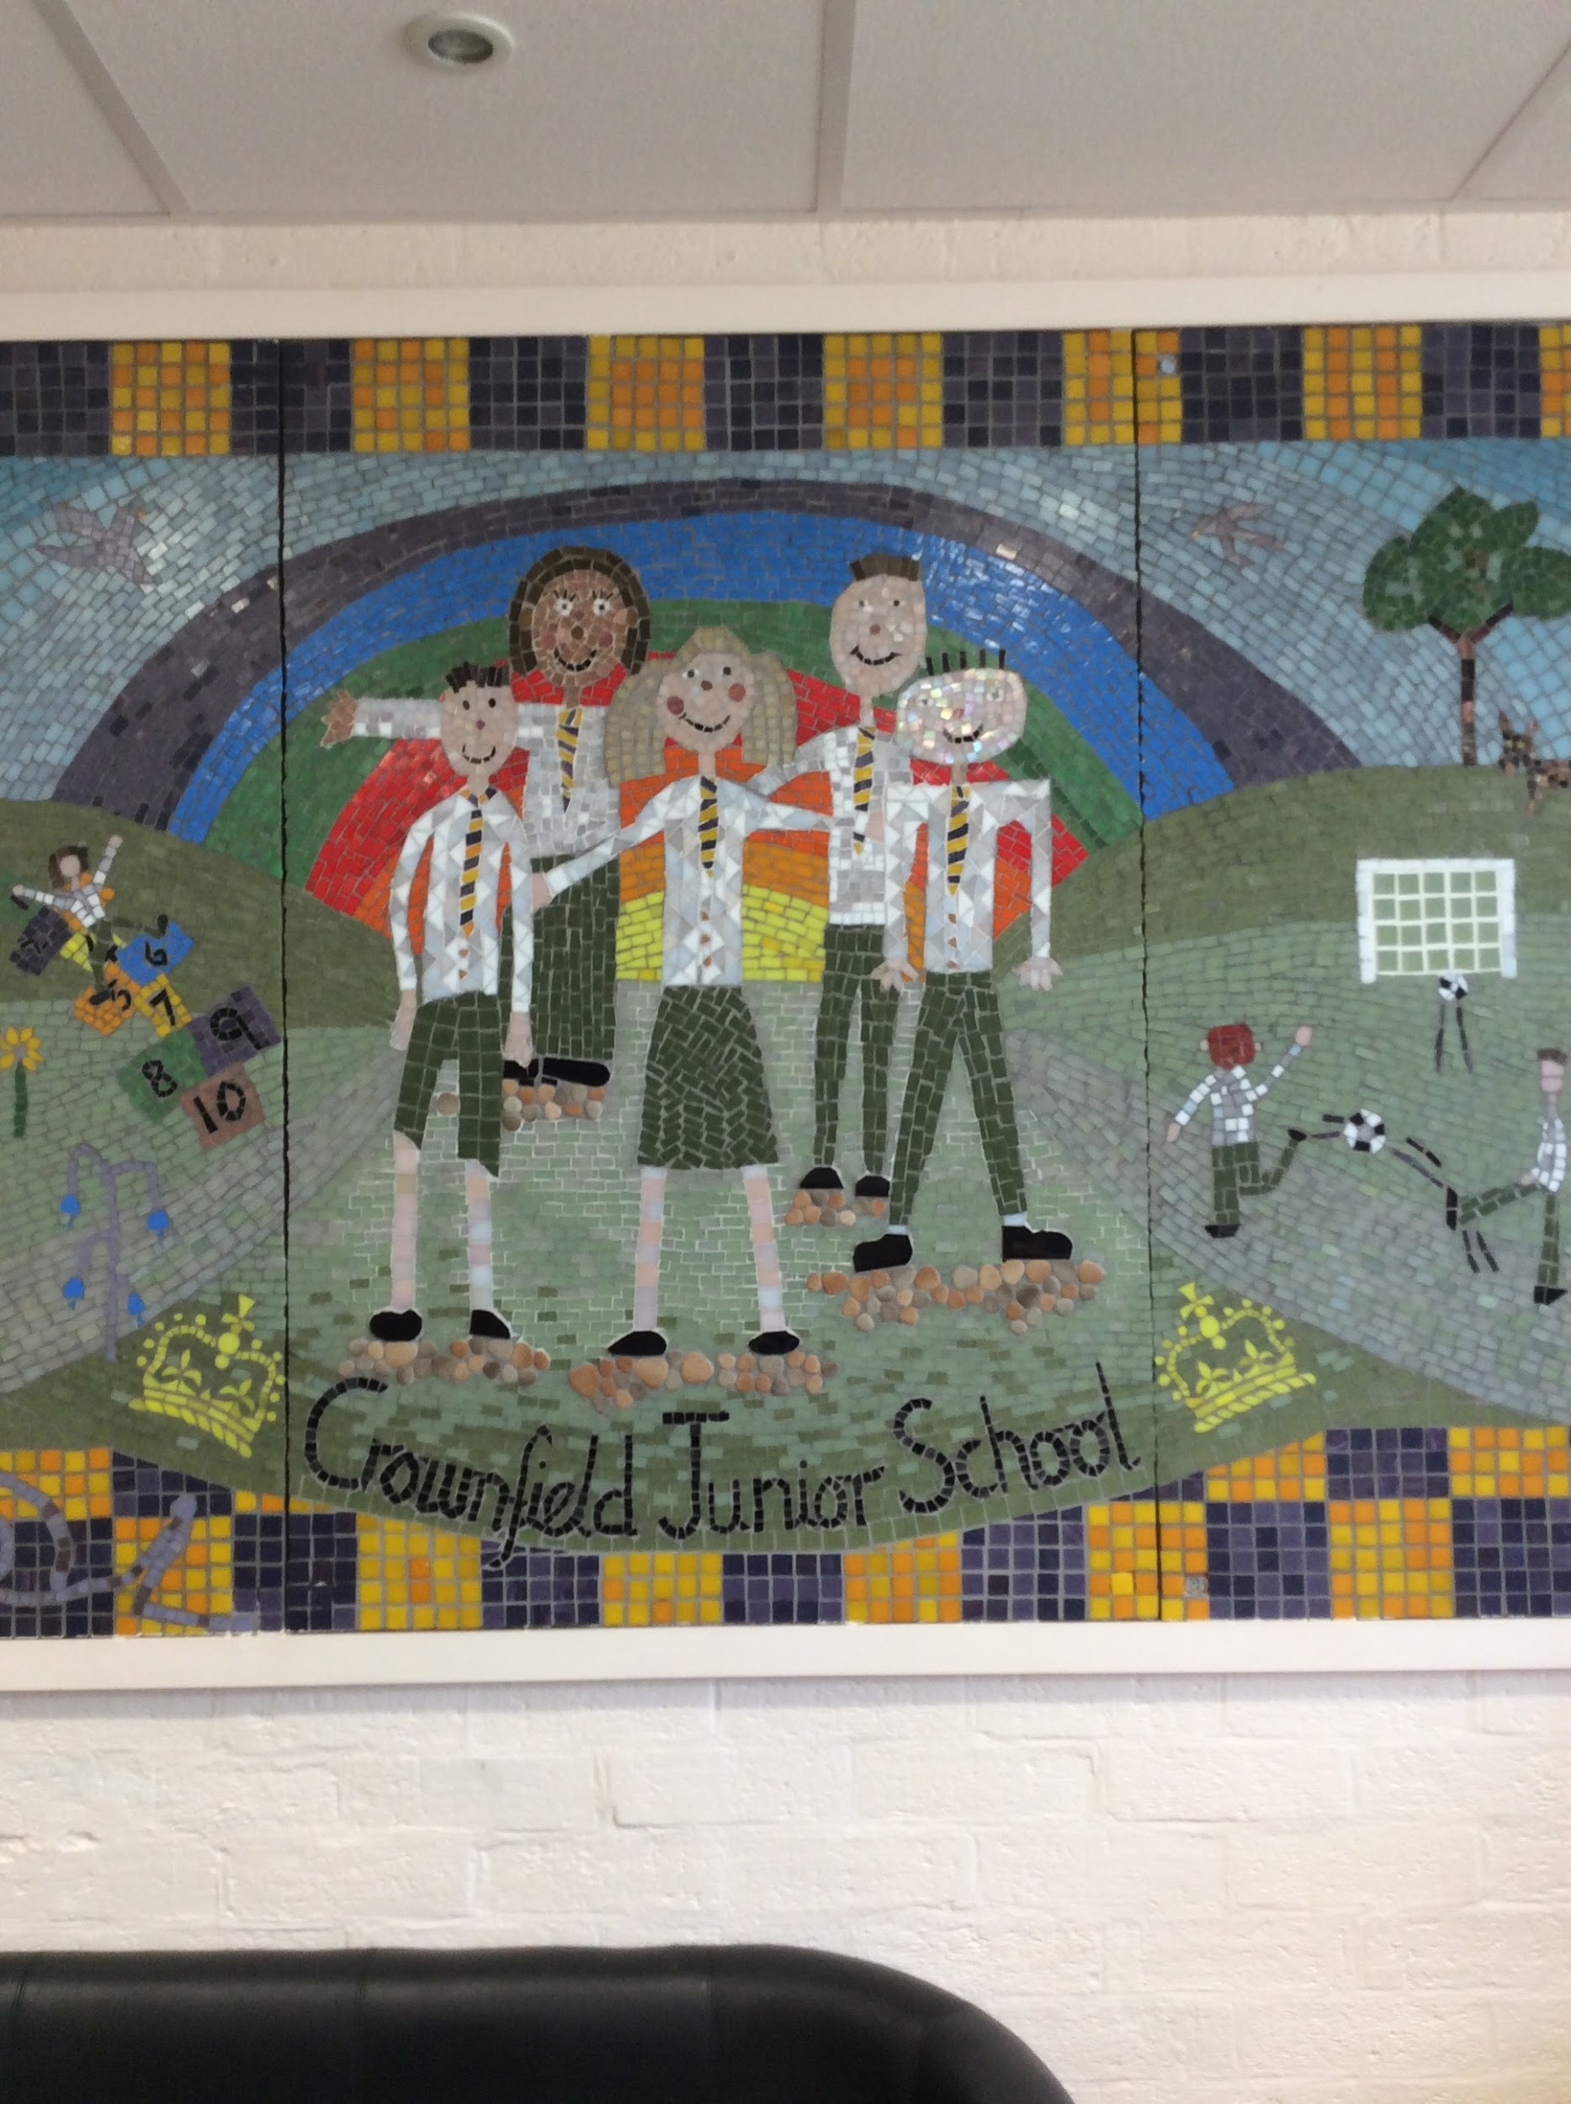
Together, we are Crownfield!

